Slide 1
Lecture 5
Checksum

Slide 2
    CHECKSUM
Checksum is an error-detecting technique that can be applied to a message of any length. In the Internet, the checksum technique is mostly used at the network and transport layer rather than the data-link layer.
Like VRC, LRC & CRC, this method is also based on the concept of redundancy.
10.<number>
Notes:
10.#

Slide 3
Several protocols still use checksum for error detection although the tendency to replace it with CRC. As CRC is also used in other layers as well.
Checksum is an error detection technique which can be applied to a message of any length.

Slide 4
Checksum Generator/sender
Checksum Generator/sender follows following steps:
  The unit is divided into k sections, each of n bits ( normally 16)
  All the sections are added together using 1’s complement to get the sum
  The sum is complemented & becomes the checksum
  The checksum is sent along with the data

Slide 5
Checksum Checker/receiver
Checksum checker/receiver follows following steps
  Unit is divided into k section, each of n bits
  All sections are added together using 1’s complement to get the sum
  The sum is complemented
  If the result is zero, the data is accepted, else it is discarded

Slide 6
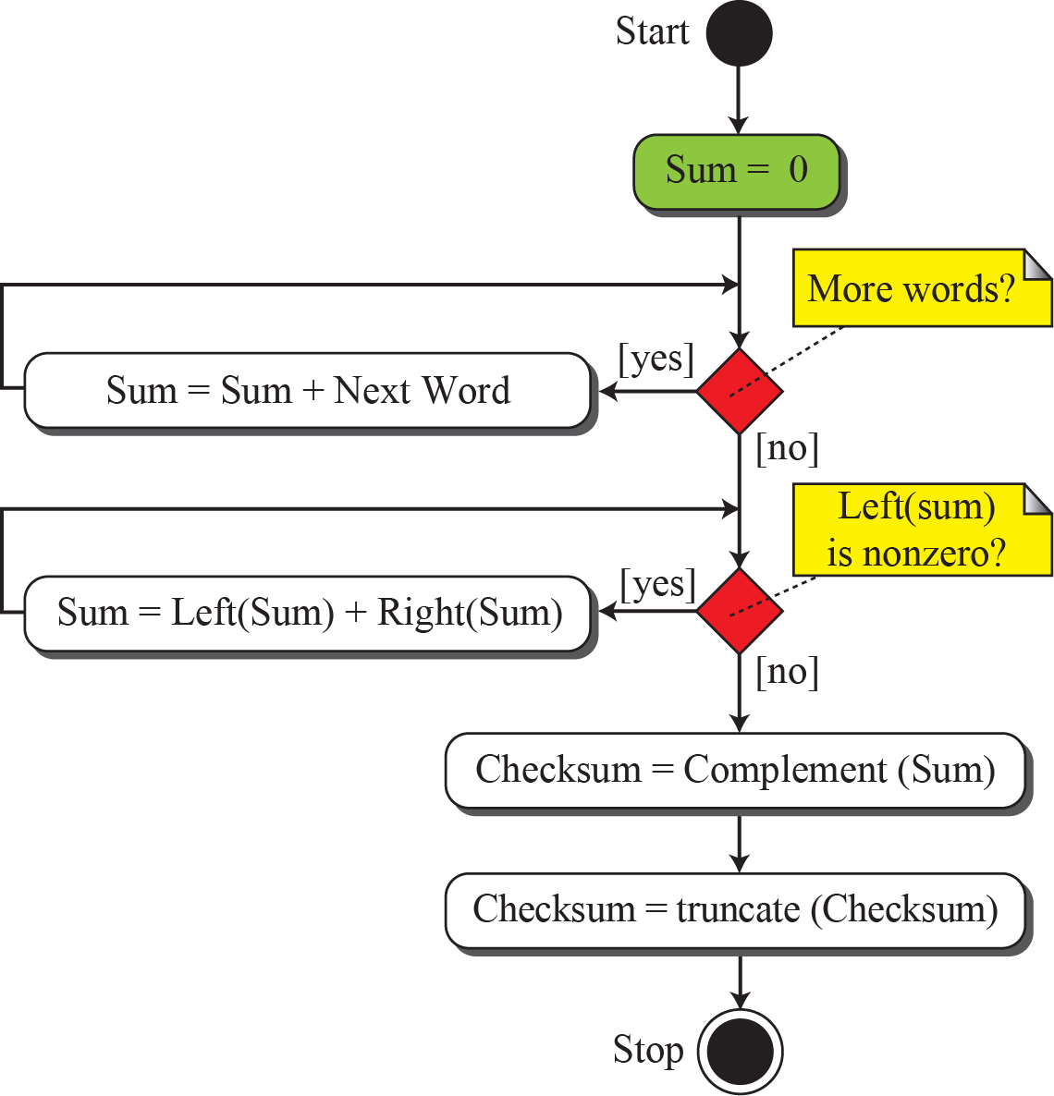
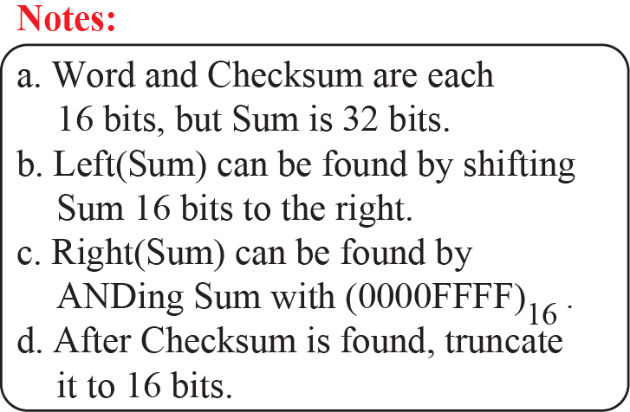
Figure: Algorithm to calculate a traditional checksum
10.<number>
Notes:
10.#

Slide 7
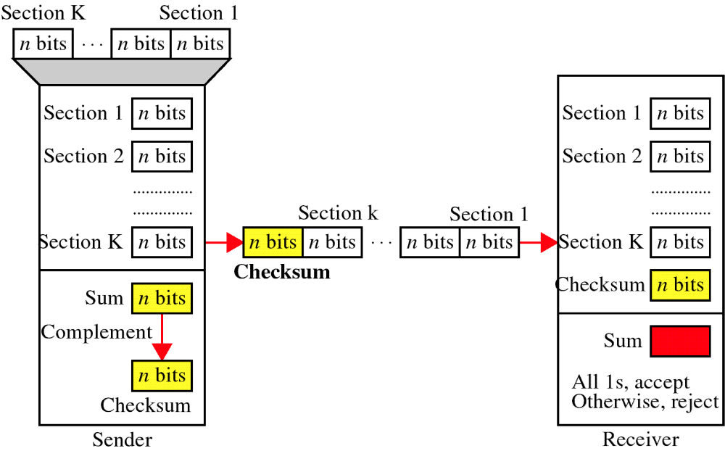
Checksum

Slide 8
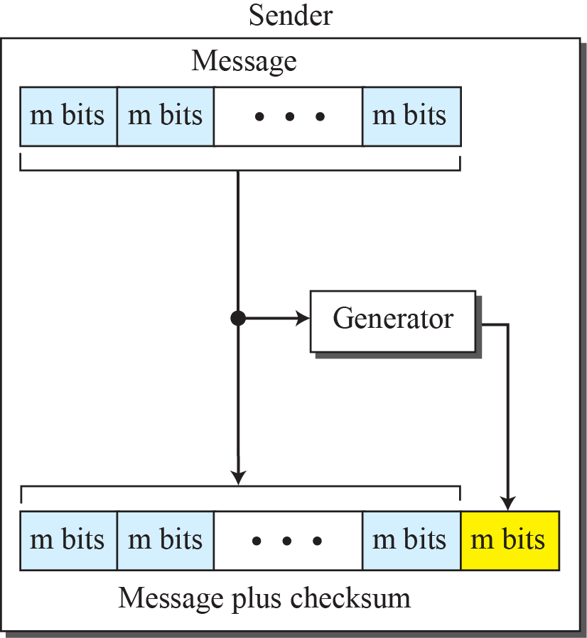
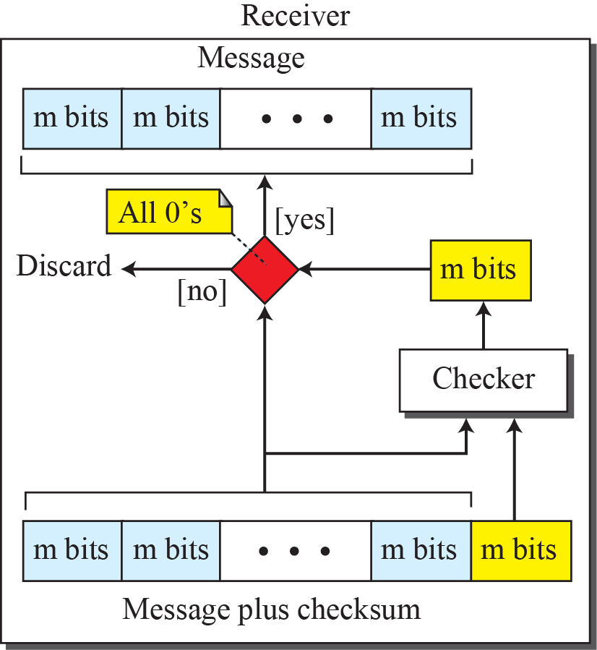
Figure: Checksum
10.<number>
Notes:
10.#

Slide 9
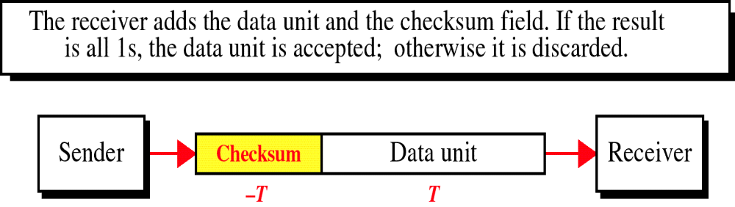
Data Unit and Checksum

Slide 10
Understanding 1s complement
Definition : In one’s complement, we can represent unsigned number between 0 and 2^{n} -1 using only n bits. If the number has more than n bits, the extra leftmost bits need to be added to the n rightmost bits.
Example : How we can represent the number 21 in one’s complement arithmetic using only four bits?
Solution
The number 21 in binary is 10101 (it needs five bits). We can wrap the leftmost bit and add it to the four rightmost bits. We have (0101+1) = 0110 or 6.

Slide 11
Example : How can we represent the number -6 in one’s complement arithmetic using only four bits?
Solution
In one’s complement arithmetic, the negative or complement of a number is found by inverting all bits. Positive 6 is 1001. if we consider only unsigned numbers, this is 9. in other words the complement of 6 is 9. another way to find the complement of a number in one’s complement arithmetic is to subtract the number from 2^{n} -1 (16 -1 in this case)

Slide 12
Example : change -77 to its one’s complement form.
Solution
  a. The absolute value is 77.
  B. 77 in binary is 1001101
  C. adding 0s to make the number 16 bits long gives us 0000000001001101.
  D. The sign was negative, so we complement the number obtained in step c by inverting its digits, giving us 1111111110110010.

Slide 13
Example 1
Suppose the following block of 16 bits is to be sent using a checksum of 8 bits.
10101001 00111001
The numbers are added using one’s complement arithmetic
10101001
00111001
---------------
Sum 11100010
Checksum 00011101
The pattern sent is :
10101001 00111001 00011101
Checksum

Slide 14
Example 2
Now suppose the receiver receives the pattern sent in Example 1 and there is no error.
10101001 00111001 00011101
When the receiver adds the three sections together, it will get all 1s, which , after complementing, is all 0s and shows that there is no error.
10101001
00111001
00011101
-----------
Sum 11111111
Complement 00000000 means that the pattern is OK.

Slide 15
Example 3
Now suppose there is a burst error of length five that affects four bits.
10101111 11111001 00011101
When the receiver adds the three sections together, it gets
10101111
11111001
00011101
--------------------------
Result 1 11000101
Carry 1
--------------------------
Sum 11000110
Complement 00111001 means that the pattern is corrupted.

Slide 16
Example
Suppose the message is a list of five 4-bit numbers that we want to send to a destination. In addition to sending these numbers, we send the sum of the numbers. For example, if the set of numbers is (7, 11, 12, 0, 6)
we send (7, 11, 12, 0, 6, -36), where -36 is checksum which is the complement of sum of the original numbers. The receiver adds the five numbers and compares the result with the sum. If the two are the same, the receiver assumes no error, accepts the five numbers, and discards the sum. Otherwise, there is an error somewhere and the message not accepted.

Slide 17
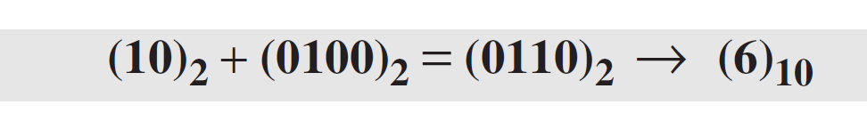
Example
In the previous example, the decimal number 36 in binary is (100100)2. To change it to a 4-bit number we add the extra leftmost bit to the right four bits as shown below.
Instead of sending 36 as the sum, we can send complement of 6 i.e. -6 as the check sum (7, 11, 12, 0, 6, -6). The receiver can add the first five numbers in one’s complement arithmetic. If the result is 6, the numbers are accepted; otherwise, they are rejected.

Slide 18
Example
Let us use the idea of the checksum in previous Example. The sender adds all five numbers in one’s complement to get the sum = 6. The sender then complements the result to get the checksum = 9, which is 15 − 6. Note that 6 = (0110)2 and 9 = (1001)2; they are complements of each other. The sender sends the five data numbers and the checksum (7, 11, 12, 0, 6, 9). If there is no corruption in transmission, the receiver receives (7, 11, 12, 0, 6, 9) and adds them in one’s complement to get 15.

Slide 19
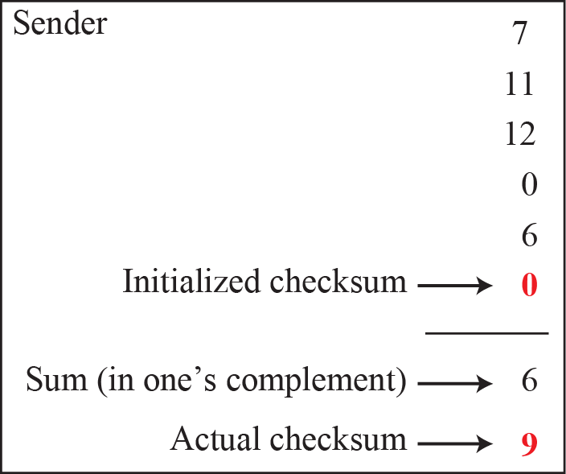
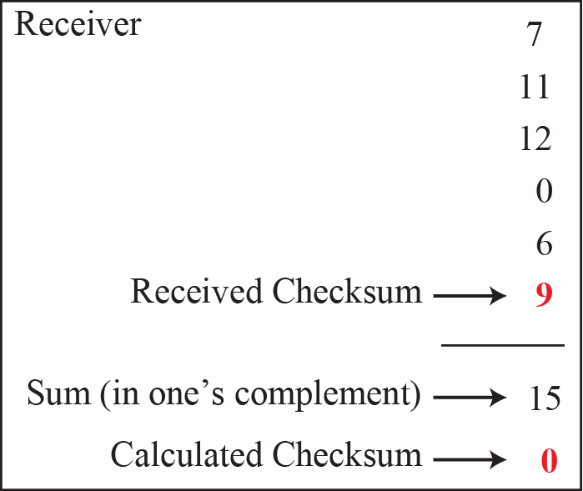
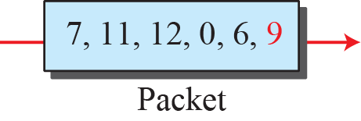
Figure 10.16: Example 10.13
Notes:
10.#

Slide 20
Internet Checksum
Traditionally, the Internet has been using a 16-bit checksum. The sender calculates the checksum by following these steps.
Sender site:
The message is divided into 16-bit words.
The value of the checksum word is set to 0.
All words including the checksum are added using one’s complement addition.
The sum is complemented and becomes the checksum.
The checksum is sent with the data.

Slide 21
The receiver uses the following steps for error detection.
Receiver site:
The message (including checksum) is divided into 16-bit words.
All words are added using one’s complement addition.
The sum is complemented and becomes the new checksum.
If the value of checksum is 0, the message is accepted; otherwise, it is rejected.

Slide 22
The nature of the checksum (treating words as numbers and adding and complementing them) is well-suited for software implementation. Short programs can be written to calculate the checksum at the receiver site or to check the validity of the message at the receiver site.

Slide 23
Example
Let us calculate the checksum for a text of 8 characters (“Forouzan”). The text needs to be divided into 2-byte (16-bit) words. We use ASCII (see Appendix A) to change each byte to a 2-digit hexadecimal number. For example, F is represented as 0x46 and o is represented as 0x6F. Figure 10.25 shows how the checksum is calculated at the sender and receiver sites.

Slide 24
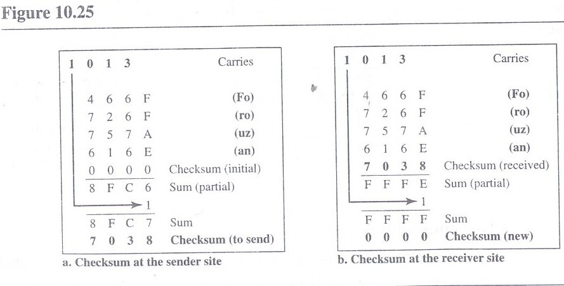

Slide 25
Performance of checksum
The checksum detects all errors involving an odd number of bits, as well as most errors involving an even number of bits.
However, if one or more bits of a segment are damaged and the corresponding bit or bits of opposite value in a second segment are also damaged, the sums of those columns will not change and the receiver will not detect a problem.
If the last digit of one segment is a 0 and it gets changed to a 1 in transit, then the last 1 in another segment must be changed to a 0 if the error is to go undetected.
In LRC, two 0s could both change to 1s without altering the parity because carries were discarded.
Checksum retains all carries; so although two 0s becoming 1s would not alter the value of their own column, they would change the value of the next higher column.
But anytime a bit inversion is balanced by an opposite bit inversion in the corresponding digit of another data segment, the error is invisible.

